Slide 1
Improving Lives in Ghana
With The Links Donation of a Borehole in Pigu, ghana
Communication for Social Change Consortium
www.cfsc.org

Slide 2
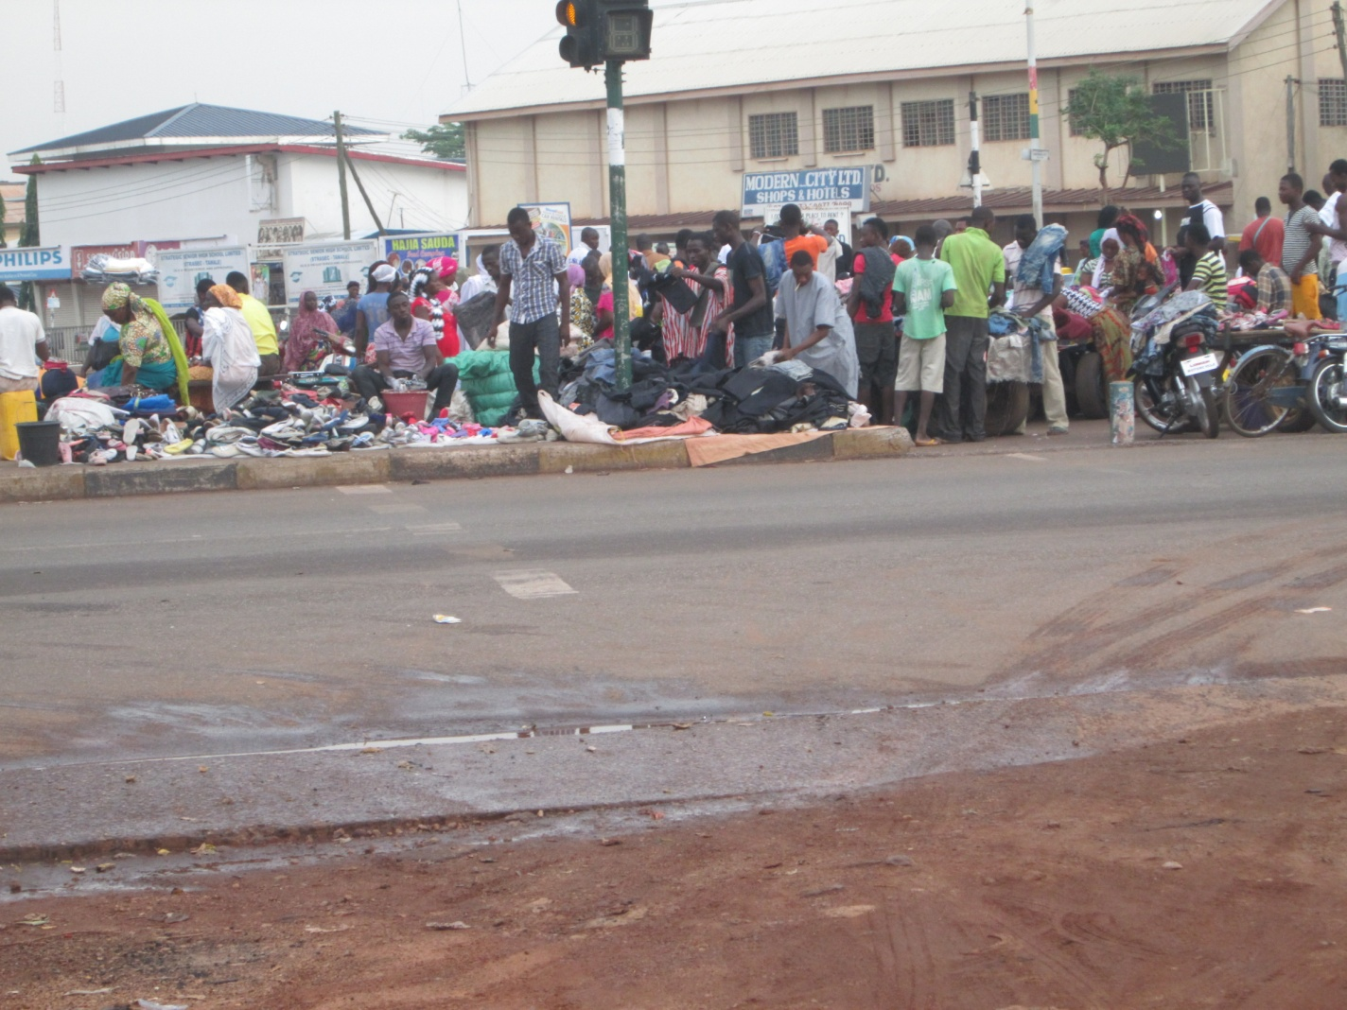
Market day in Pigu brings out many of the local residents. They gather here to shop for food and household supplies – including clothing. Those who can afford it may also buy bottled water here. Throughout Ghana, soft drinks – especially Coca Cola products like regular Coke and Fanta – are less expensive than water. So children and adults alike are consuming soft drinks at a higher rate than they consume clean water, in some locations of the country.

Slide 3
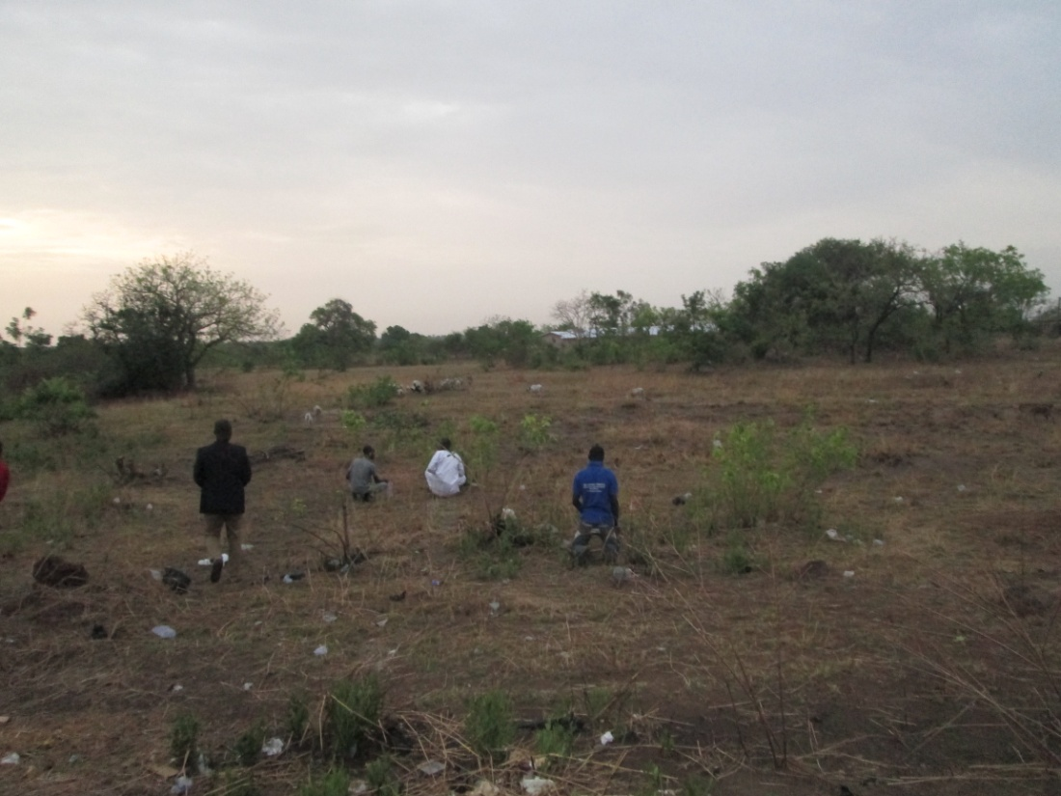
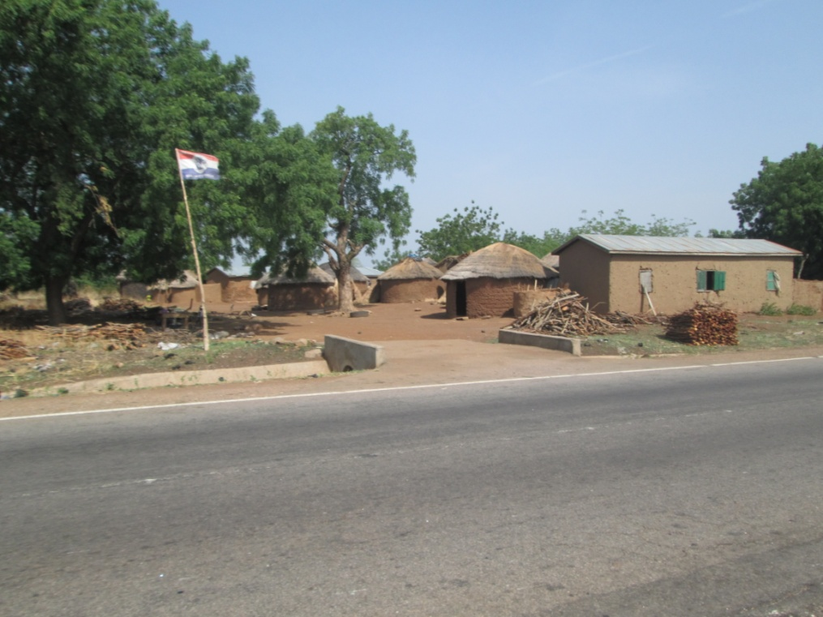
Typical housing and fields in and near Pigu, where the Links-provided borehole is.
A borehole is a type of well that is pumped and can be kept clean by the local townspeople dropping tablets into the borehole every few months. It is an expensive and reliable source of clean water.

Slide 4
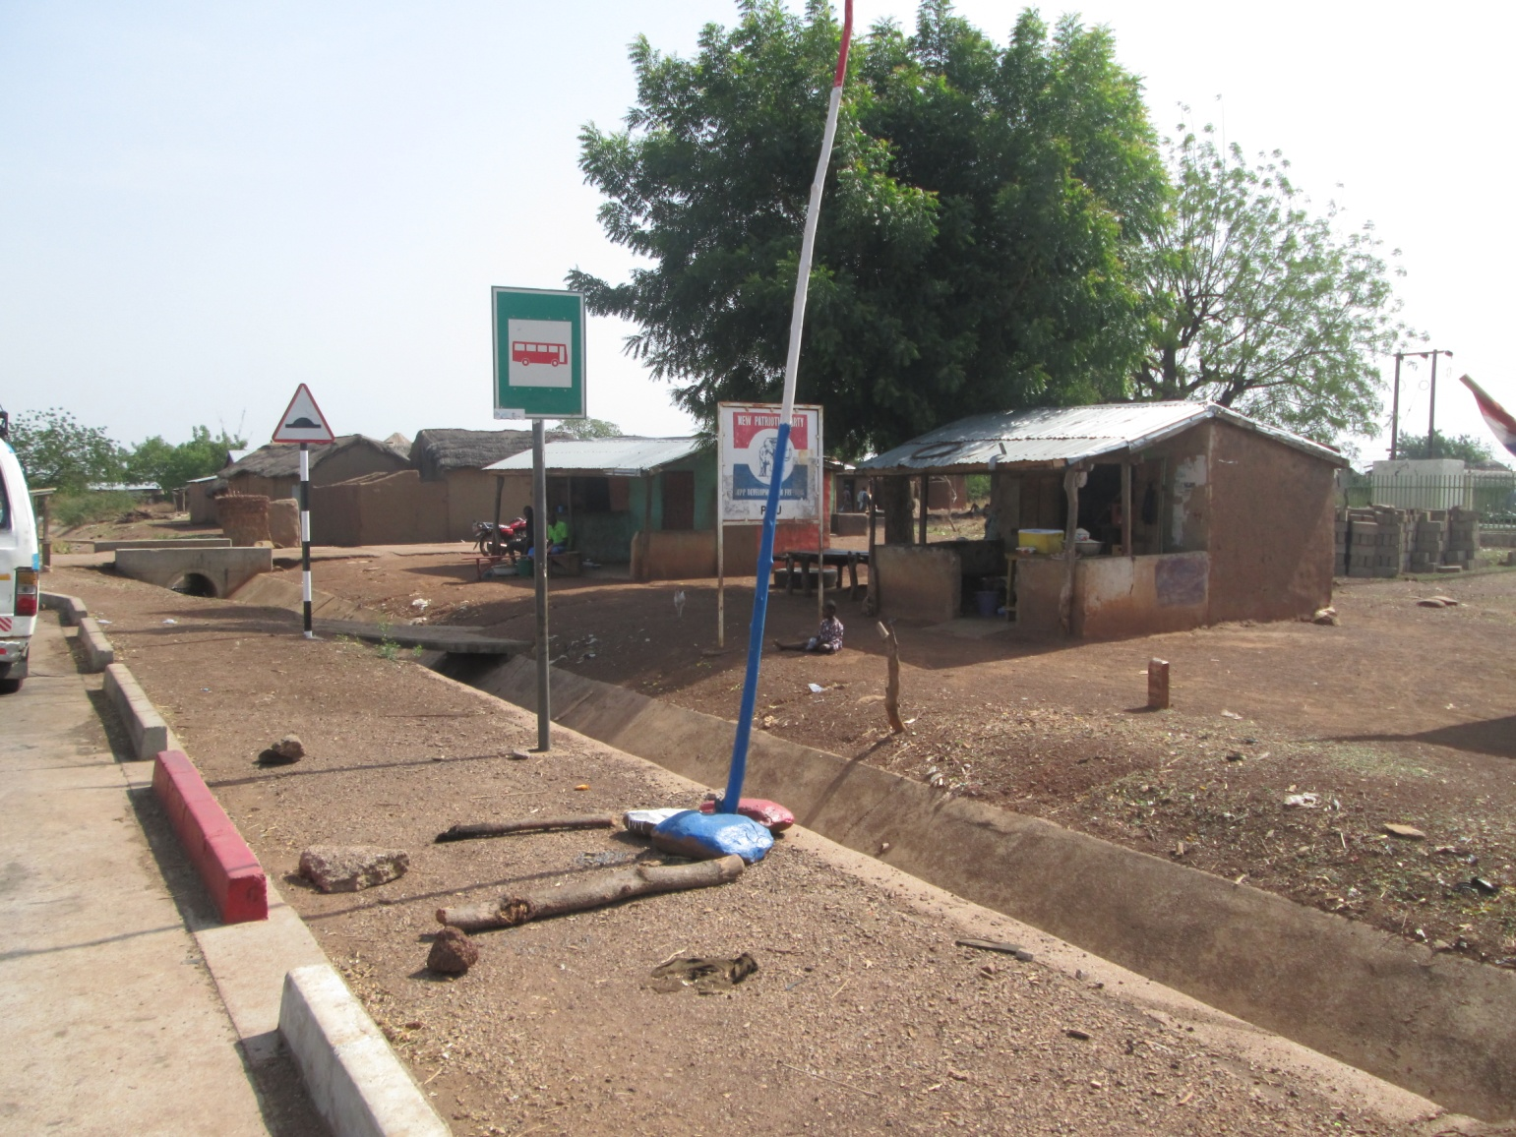
To travel to Pigu, our representative had to take a bus for 9 hours from Accra, Ghana’s capitol city, to Tamale (a northern city), and then transfer to another bus for the 1.5 hour trip to Pigu. This is the bus stop in Pigu.

Slide 5
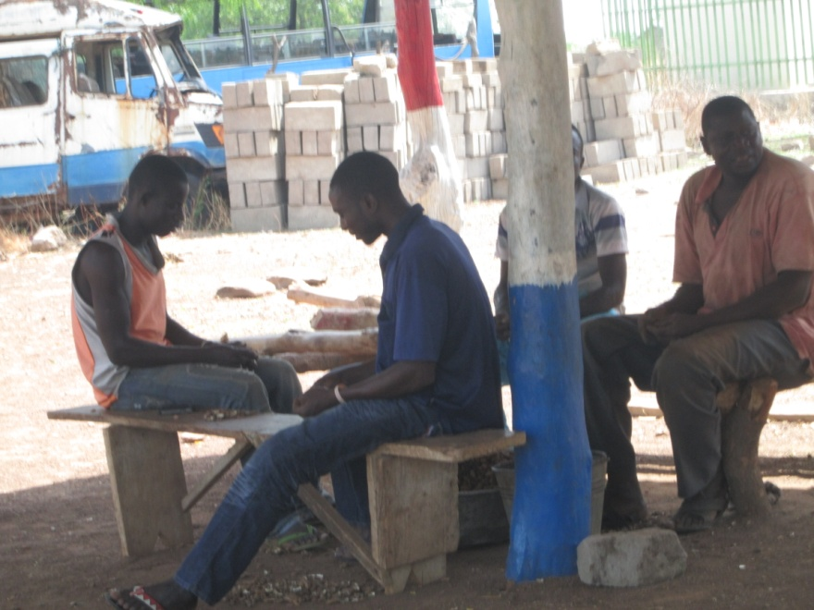
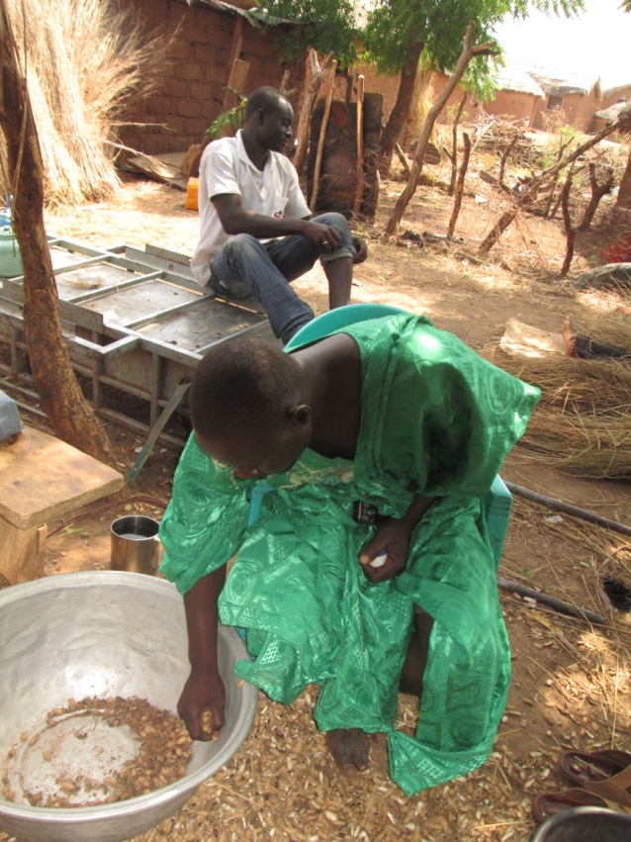
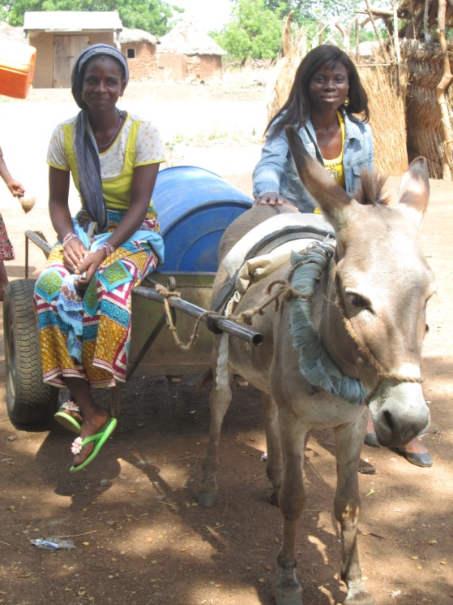
The young woman in the bottom photo with our representative, Mary in the blue jacket, is lucky to have a small donkey to carry a large barrel that she fills with water at the Links-provided borehole.
Most activities in this village occur outside including cooking (young girl in green), entertainment and bathing.

Slide 6
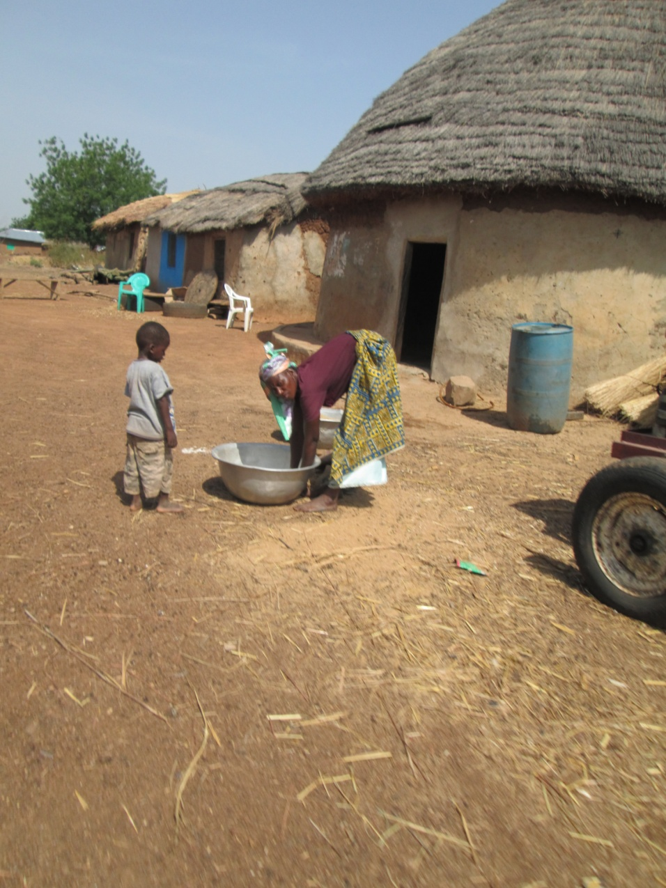
This mother cooks for her family outside the home and bathes her young children with water from the borehole. The walls of the home are made with cow dung; the roof is thatched with local grasses.

Slide 7
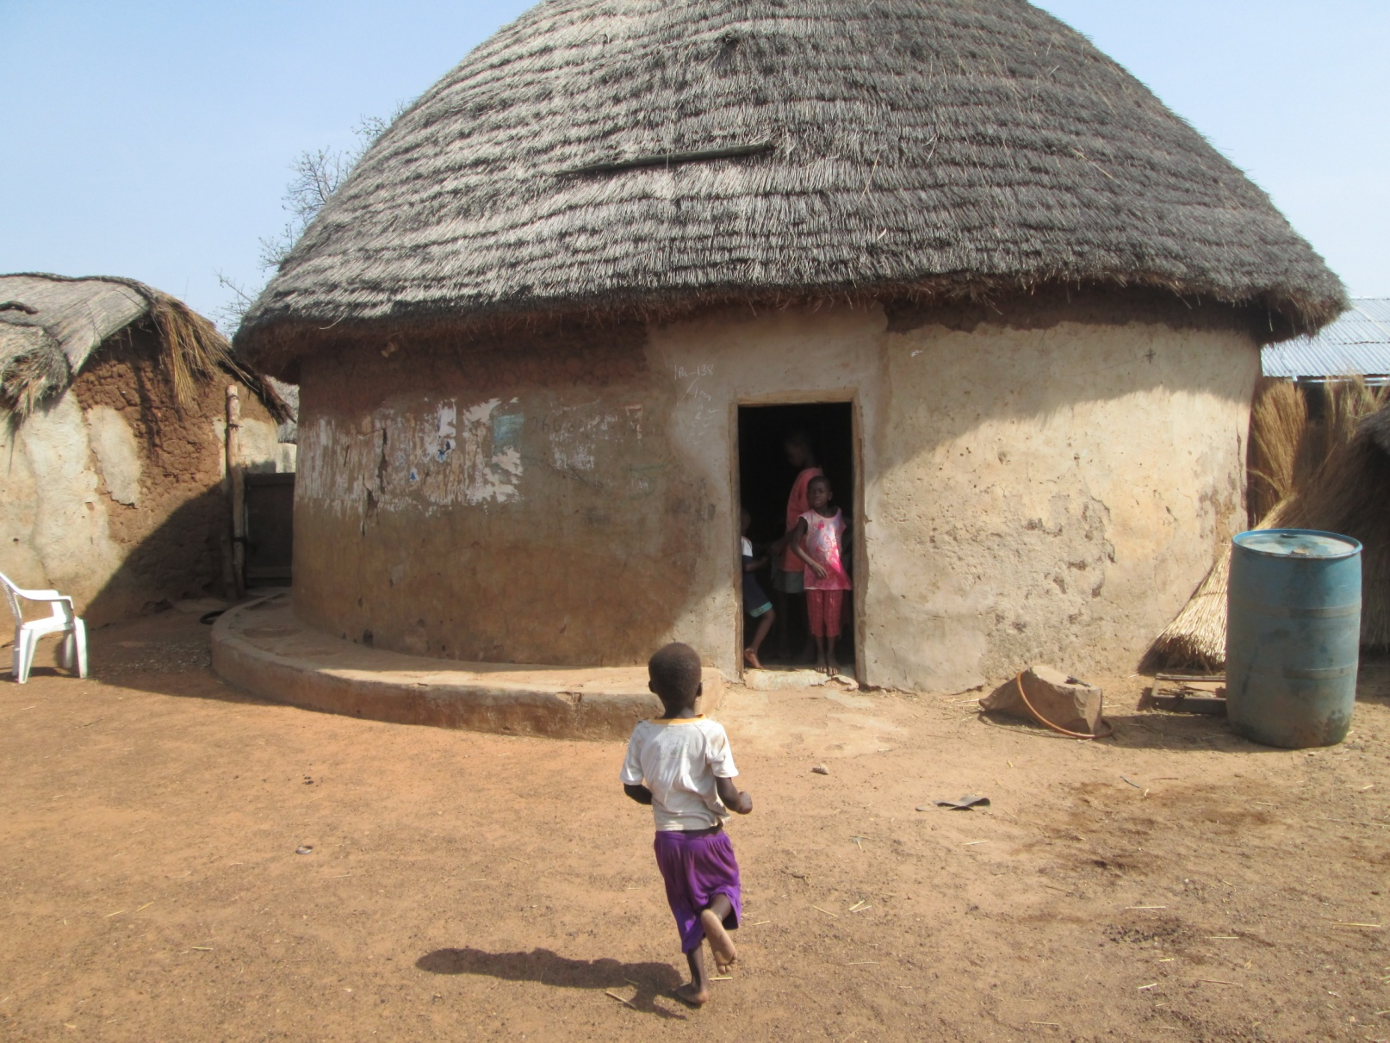
The blue barrel to the right of the home is used to collect rain water as well as to collect water from the borehole. This is not that rainy season and rain has not happened in many months.

Slide 8
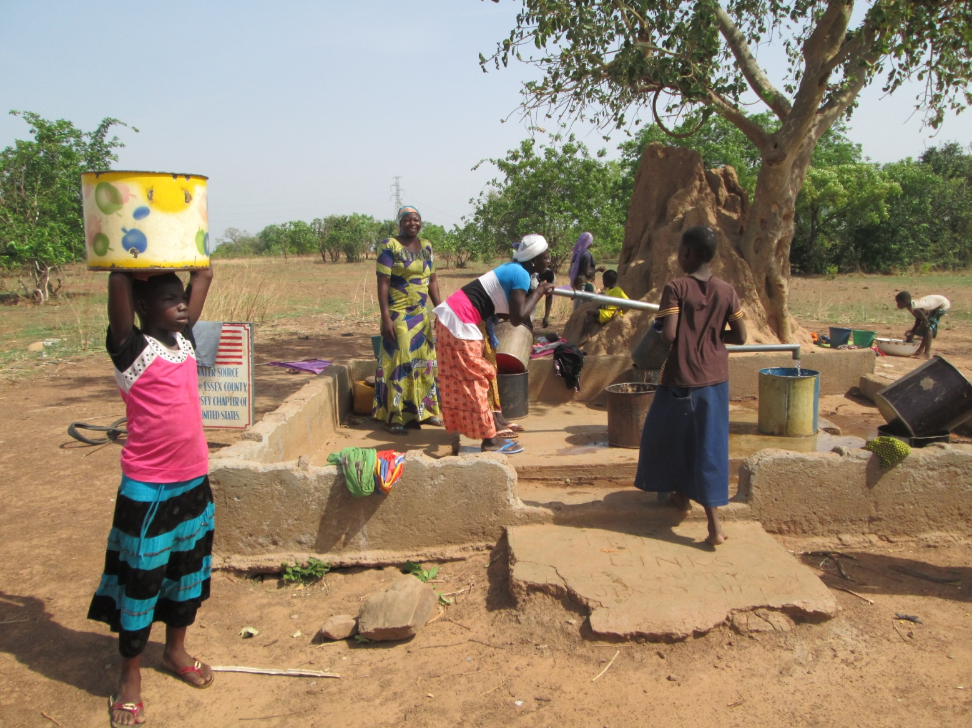
Women, girls and young boys are the only ones sent to collect water. The women and girls typically collect water for their daily needs every morning before 5:30 am – once the sun comes up. Some travel as far as 2 or 3 kilometers to collect their water each morning. They often carry the filled buckets on the heads – and it is not unusual to also have a baby strapped to their backs. This is the borehole built with Links funds -- $5,000 USD.

Slide 9
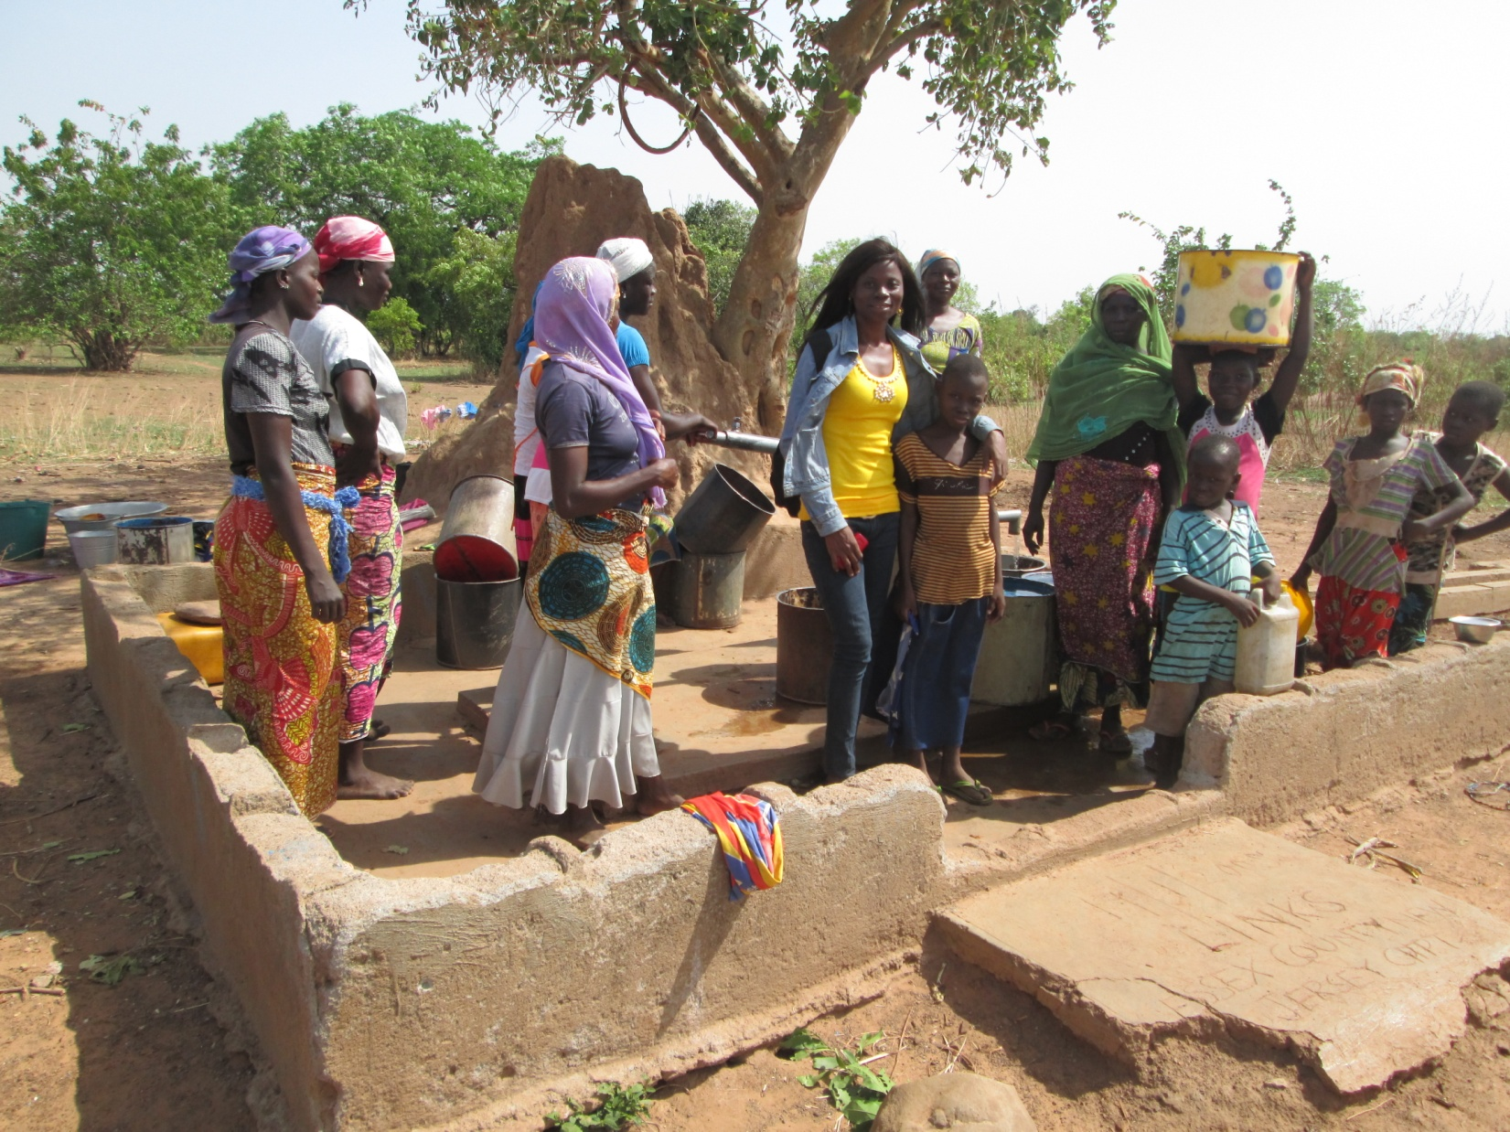
Towns women and children collect water in any vessel they have at their disposal. If girls of school age do not collect the water early in the morning, they may not be allowed to go to school.

Slide 10
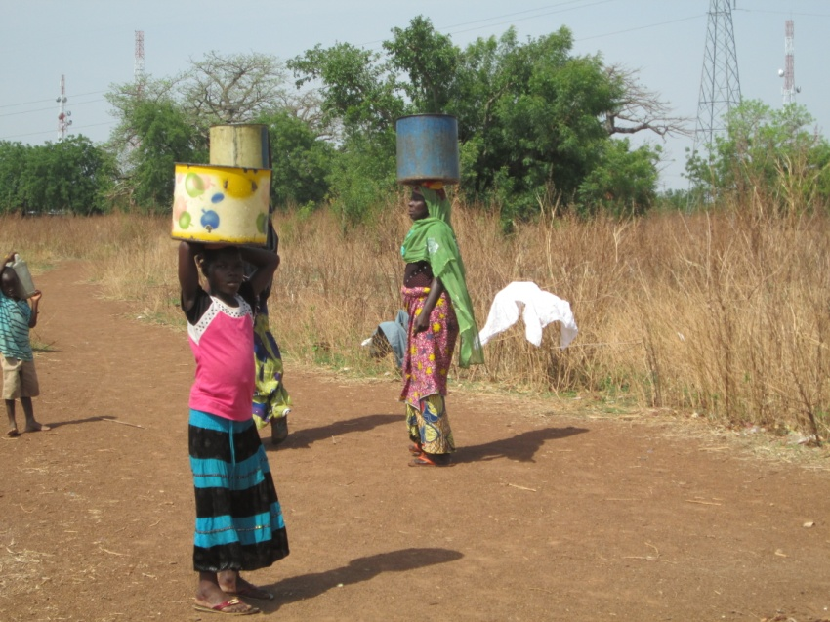
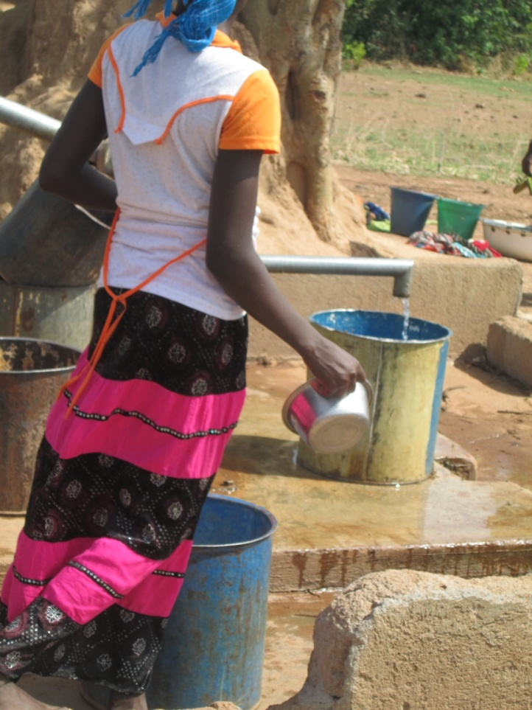
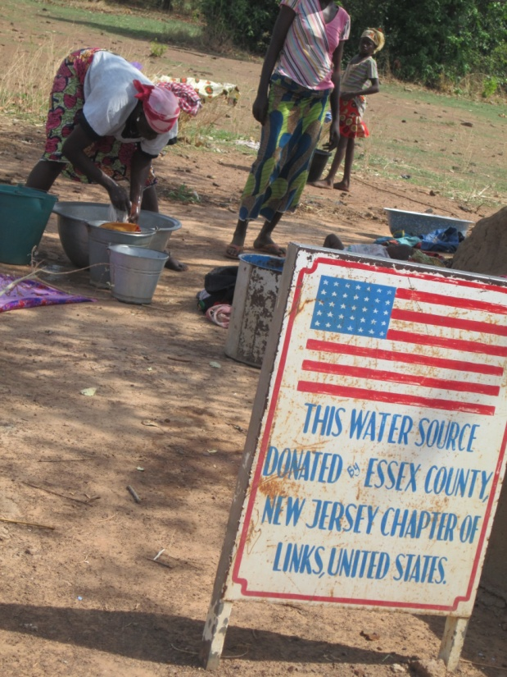
Travelling back home with containers filled with water is a daily excursion – the borehole is also where women can meet and talk with each other socially.

Slide 11
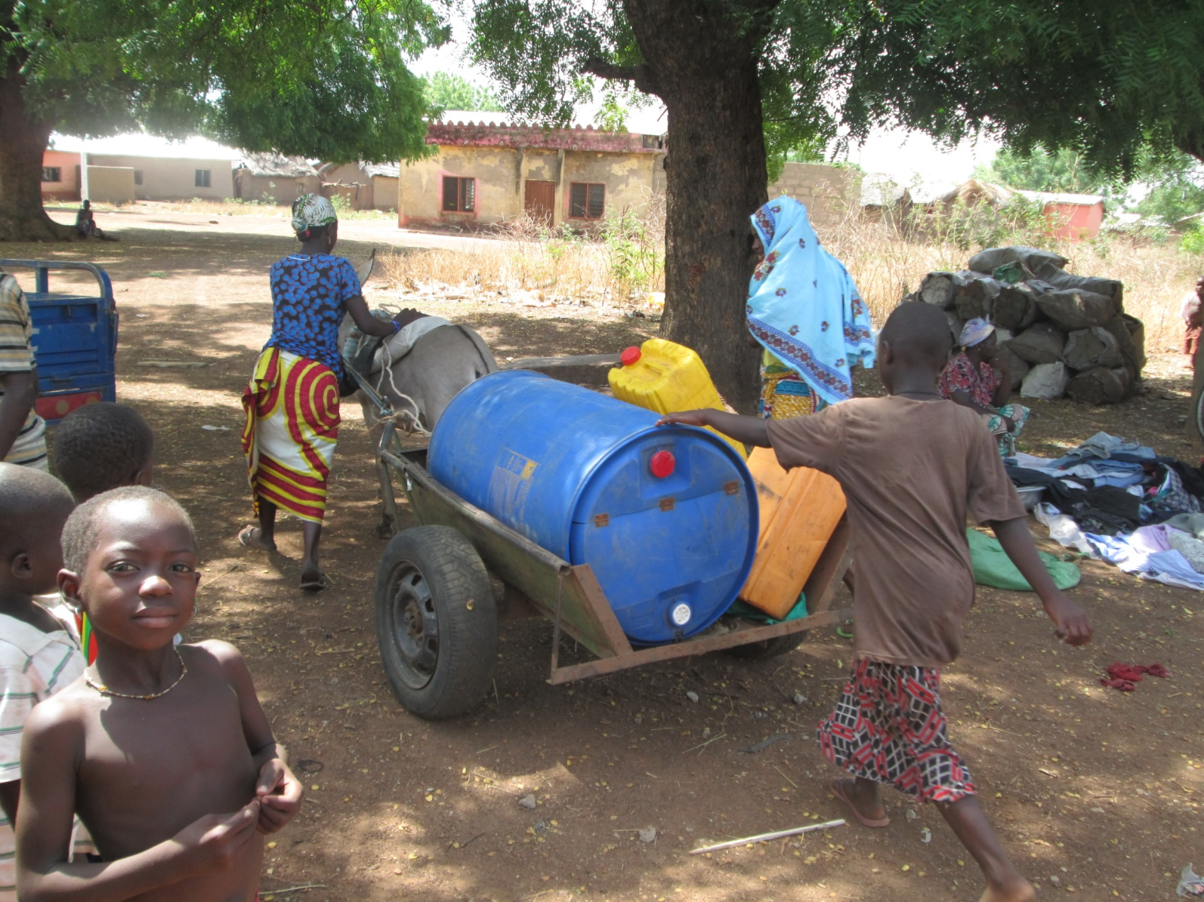
The donkey we saw earlier is now taking the filled barrel home for these local residents. Note that the yellow and orange containers on the wagon were originally filled with cooking oil. These types of containers are used for many things in Ghana. One worry is that they may not be thoroughly cleaned out before the water is put into them.

Slide 12
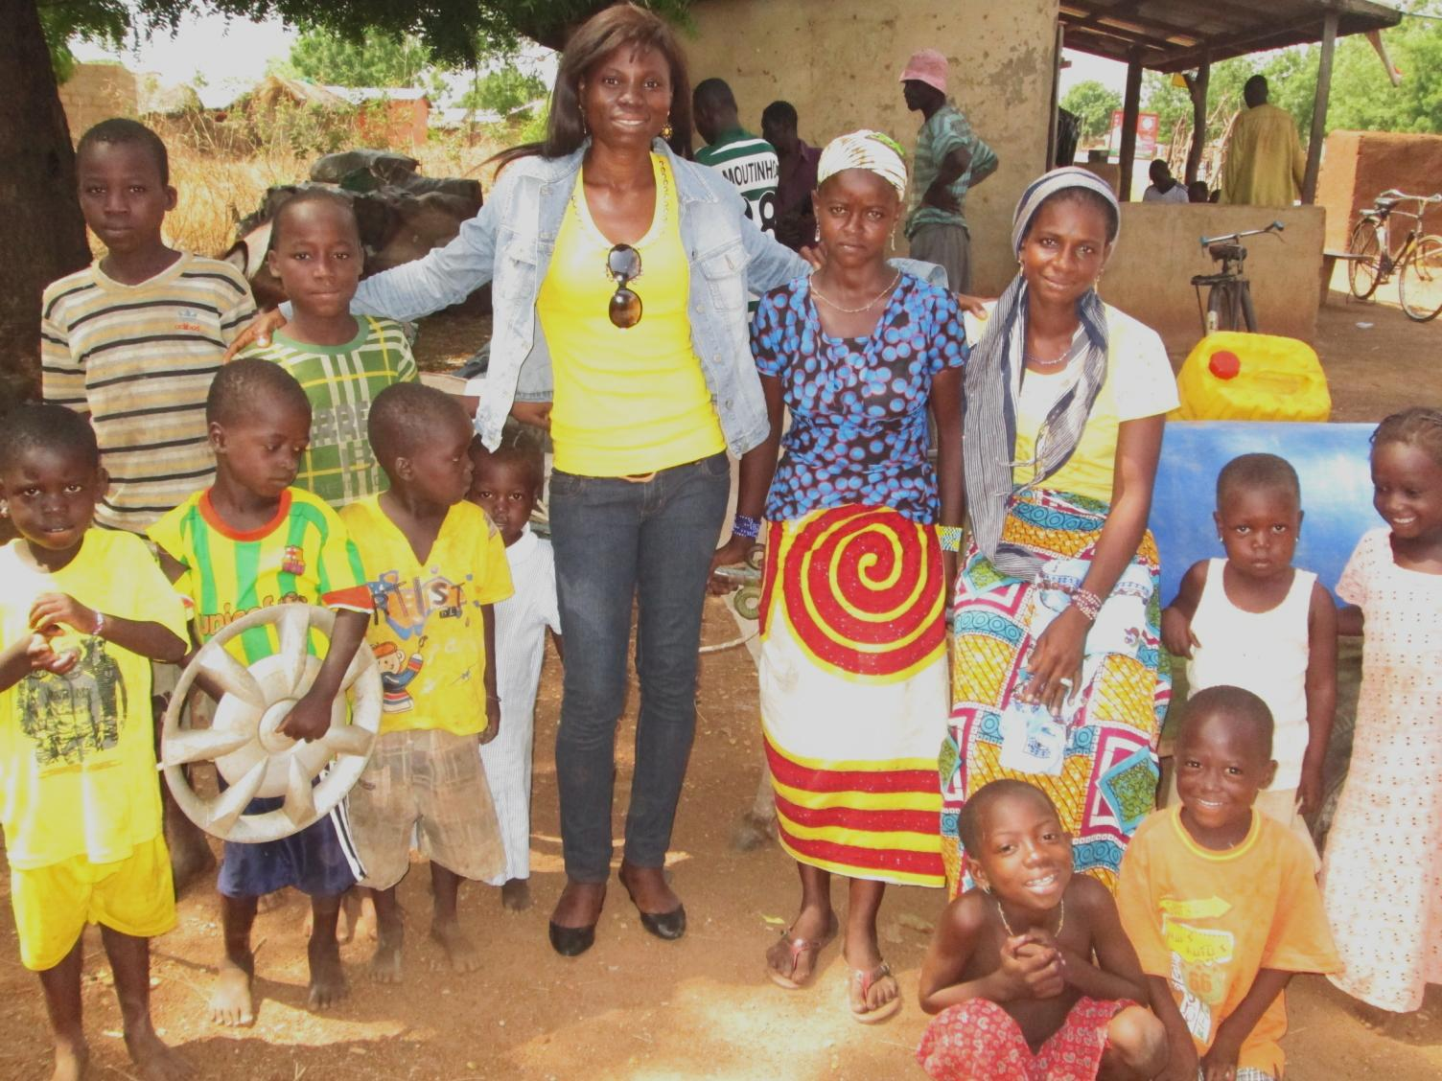
The townspeople of this village near Pigu send their love and thanks to the Links. Your contribution has helped ease the burden for many young mothers and other women, as well as reduced the incidence of water-borne diseases in this area. We hope that as clean water is provided in more villages like this one, that more girls can go to school because they have a shorter distance to travel to collect water for their families. Your donation is improving lives on multiple levels. Thank you! Special thanks to Mary Sassah, from Nsawam, Ghana who travelled to Pigu to put together this photo essay for us.

